Slide 1
Basics of NLP
Natural Language Processing (NLP) is a field of artificial intelligence (AI) that enables computers to understand, interpret, and generate human language. It's the technology behind virtual assistants like Siri and Google Assistant, language translation apps, and spam filters.
Text data is the primary type of data that NLP systems work with. It's essentially any information that is stored in the form of written language. Unlike structured data (like numbers in a spreadsheet), text data is unstructured, meaning it doesn't have a predefined format.

Slide 2

Basics of NLP
Examples of Text Data:
Social media posts (tweets, Facebook updates)
Customer reviews on e-commerce sites
News articles and blog posts
Emails and text messages
Entire books and legal documents

Slide 3
Basics of NLP
Key Concepts in NLP:
Concept | Description
Corpus | A large collection of text used for analysis.
Token | A single word or term extracted from text.
Vocabulary | The set of unique tokens in a corpus.
Stopwords | Common words (e.g., "the", "is", "and") often removed.

Slide 4
Basics of NLP
Concept | Description
Corpus | A large collection of text used for analysis.
Token | A single word or term extracted from text.
Vocabulary | The set of unique tokens in a corpus.
Stopwords | Common words (e.g., "the", "is", "and") often removed.
Key Concepts in NLP:
Key Characteristics:
Unstructured: No predefined format (e.g., emails, tweets, books)
High Dimensionality: Unique words create thousands of features
Context-Dependent: Meaning changes with context (e.g., "bat" = animal or sports equipment)

Slide 5
Basics of NLP: Text Preprocessing
Before we can analyze text, it needs to be cleaned and prepared. This crucial step is called text preprocessing. The goal is to convert messy, raw text into a clean, structured format that a machine can understand.
Common Preprocessing Steps
Tokenization: Breaking down a body of text into smaller units, called tokens. Most commonly, this means splitting a sentence into individual words.
Example: "Dhaka is a vibrant city." becomes ["Dhaka", "is", "a", "vibrant", "city", "."]

Slide 6
Basics of NLP: Text Preprocessing
Lowercasing: Converting all text to lowercase to ensure that words like "Dhaka" and "dhaka" are treated as the same word.
Example: ["Dhaka", "is", "a", "vibrant", "city", "."] becomes ["dhaka", "is", "a", "vibrant", "city", "."]
Stop-Word Removal: Removing common words (like "is," "a," "the," "in") that provide little semantic value to the text.
Example: ["dhaka", "is", "a", "vibrant", "city", "."] becomes ["dhaka", "vibrant", "city"]Stemming and Lemmatization: Reducing words to their root or base form.

Slide 7
Basics of NLP: Text Preprocessing
Stemming and Lemmatization:
Reducing words to their root or base form.
Stemming is a crude, rule-based process that chops off the end of words. For example, "running," "runs," and "ran" might all be stemmed to "run.“
Lemmatization is a more sophisticated process that uses a dictionary to find the root form of a word (called a lemma). For example, "better" would be lemmatized to "good."

Slide 8
Basics of NLP: Text Preprocessing
Example (in R using tm package):
library(tm)
text <- c("Text Mining is fun! Let's explore it.")
corpus <- VCorpus(VectorSource(text))
corpus <- tm_map(corpus, content_transformer(tolower)) # lowercase
corpus <- tm_map(corpus, removePunctuation) # remove punctuation
corpus <- tm_map(corpus, removeWords, stopwords("english")) # remove stopwords

Slide 9
Basics of NLP: TF-IDF
TF-IDF: Measuring Word Importance
TF-IDF stands for Term Frequency-Inverse Document Frequency. It's a numerical statistic used to evaluate how important a word is to a specific document within a collection of documents (a corpus).
Term Frequency (TF): Measures how often a word appears in a single document. A word that appears many times has a higher TF.
Inverse Document Frequency (IDF): Measures how common or rare a word is across all documents. Common words (like "data") will have a low IDF score, while rare, specialized words will have a high IDF score.

Slide 10
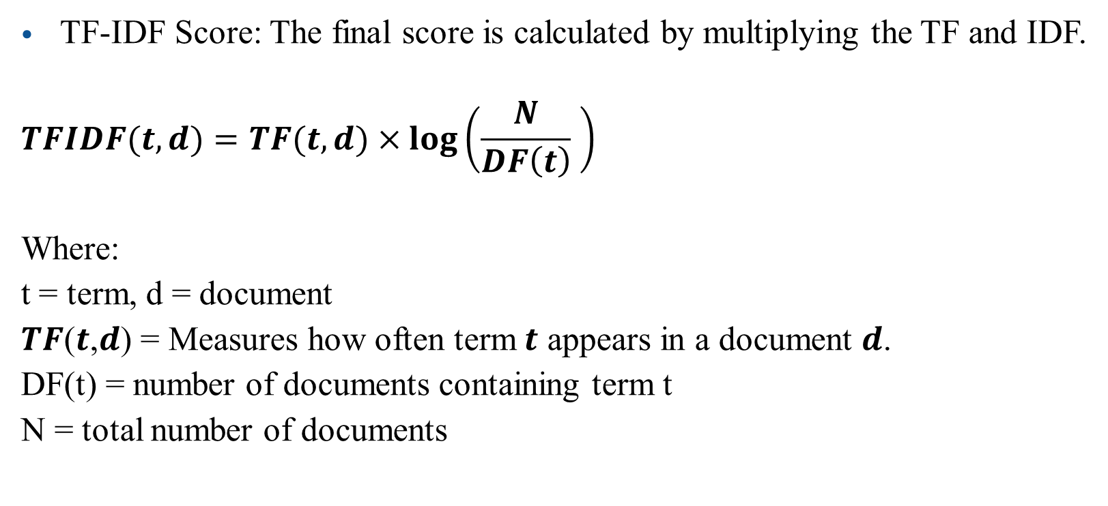
Basics of NLP: TF-IDF
TF-IDF Score: The final score is calculated by multiplying the TF and IDF.
$$TFIDF(t,d)=TF(t,d)×\log\left(\frac{N​}{DF\left(t\right)} \right)$$
Where:
t = term, d = document
𝑻𝑭(𝒕,𝒅) = Measures how often term $t$ appears in a document $d$.
DF(t) = number of documents containing term t
N = total number of documents

Slide 11
Basics of NLP: TF-IDF
Step-by-Step TF-IDF Example
Sample Corpus
Let's say we have the following two documents:
Document 1 (D1): "Data science is fun“
Document 2 (D2): "Data science is powerful"

Slide 12
Basics of NLP: TF-IDF
Step-by-Step TF-IDF Example
Step 1: Preprocess the Text
Lowercase all words
Remove punctuation (if any)
Tokenize (split into words)
After preprocessing:
D1: ["data", "science", "is", "fun"]
D2: ["data", "science", "is", "powerful"]

Slide 13
Basics of NLP: TF-IDF
Step-by-Step TF-IDF Example
Step 2: Term Frequency (TF)
Calculate how often each term appears in a document.
D1: ["data", "science", "is", "fun"]
D2: ["data", "science", "is", "powerful"]
In this case, each word appears only once in each document, so raw term frequency = 1 (or 0 if absent).
Term | TF in D1 | TF in D2
data | 1/4 | 1/4
science | 1/4 | 1/4
is | 1/4 | 1/4
fun | 1/4 | 0
powerful | 0 | 1/4

Slide 14
Basics of NLP: TF-IDF
Step-by-Step TF-IDF Example
Step 3: Document Frequency (DF)
Number of documents in which each term appears.
D1: ["data", "science", "is", "fun"]
D2: ["data", "science", "is", "powerful"]
Term | TF in D1 | TF in D2
data | 1/4 | 1/4
science | 1/4 | 1/4
is | 1/4 | 1/4
fun | 1/4 | 0
powerful | 0 | 1/4
Term | DF
data | 2
science | 2
is | 2
fun | 1
powerful | 1

Slide 15

Basics of NLP: TF-IDF
Step-by-Step TF-IDF Example
Step 4: Inverse Document Frequency (IDF)
$$IDF(t)=\log{10​}\left(\frac{N}{DF\left(t\right)} \right)$$
Where N = 2 (total number of documents)
Term | TF in D1 | TF in D2
data | 1/4 | 1/4
science | 1/4 | 1/4
is | 1/4 | 1/4
fun | 1/4 | 0
powerful | 0 | 1/4
Term | DF
data | 2
science | 2
is | 2
fun | 1
powerful | 1
Term | IDF | Value
data | log10(2/2) = log10(1) | 0.00
science | log10(2/2) = log10(1) | 0.00
is | log10(2/2) = log10(1) | 0.00
fun | log10(2/1) = log10(2) | ≈ 0.3010
powerful | log10(2/1) = log10(2) | ≈ 0.3010

Slide 16
Basics of NLP: TF-IDF
Term | TF in D1 | TF in D2
data | 1/4 | 1/4
science | 1/4 | 1/4
is | 1/4 | 1/4
fun | 1/4 | 0
powerful | 0 | 1/4
Step-by-Step TF-IDF Example
Step 5: TF × IDF
Now multiply TF with IDF for each term in each document:
Term | TF-IDF in D1 | TF-IDF in D2
data | 1/4 × 0 = 0 | 1/4 × 0 = 0
science | 1/4 × 0 = 0 | 1/4 × 0 = 0
is | 1/4 × 0 = 0 | 1/4 × 0 = 0
fun | 1/4 × 0.301 = 0.301 | 0 × 0.301 = 0
powerful | 0 × 0.301 = 0 | 1 × 0.301 = 0.301
Term | IDF Value
data | 0.00
science | 0.00
is | 0.00
fun | ≈ 0.3010
powerful | ≈ 0.3010

Slide 17
Basics of NLP: TF-IDF
Term | TF in D1 | TF in D2
data | 1/4 | 1/4
science | 1/4 | 1/4
is | 1/4 | 1/4
fun | 1/4 | 0
powerful | 0 | 1/4
Common words like "data", "science", and "is" have TF-IDF = 0 because they appear in all documents (not informative).
Unique words like "fun" and "powerful" have higher TF-IDF values, making them more important for distinguishing between the documents.
Term | TF-IDF in D1 | TF-IDF in D2
data | 0 | 0
science | 0 | 0
is | 0 | 0
fun | 0.301 | 0
powerful | 0 | 0.301
Term | Value
data | 0.00
science | 0.00
is | 0.00
fun | ≈ 0.3010
powerful | ≈ 0.3010

Slide 18
Basics of NLP: Word Frequency and Word Clouds
Word Frequency: This is the simplest form of text analysis. It involves counting how many times each word appears in a given text after preprocessing. This simple count can already provide valuable insights into the main topics of the text.
Word Clouds: A word cloud is a visual representation of word frequency. In a word cloud, the size of each word is proportional to its frequency in the text. This allows you to see the most prominent words at a glance.
Example: A word cloud generated from customer reviews of a new phone might show the words "camera," "battery," "screen," and "fast" in large fonts, immediately telling you what features customers are discussing most.

Slide 19
Basics of NLP: Related Topics
The techniques above are the foundation for more advanced NLP tasks, such as:
Sentiment Analysis: Automatically determining the emotional tone of a text (e.g., positive, negative, or neutral).
Topic Modeling: Identifying the main abstract topics that occur in a collection of documents.
Named Entity Recognition (NER): Locating and classifying named entities in text, such as names of people, organizations, and locations.
Text Summarization: Automatically generating a short, coherent summary of a longer text.

Slide 20
Sentiment analysis using TF-IDF
Step 1: Sample Dataset
Review_ID | Review Text | Sentiment
1 | "The movie was excellent and inspiring" | Positive
2 | "I hated the movie, it was boring" | Negative
3 | "Absolutely fantastic performance" | Positive
4 | "The film was terrible and dull" | Negative

Slide 21
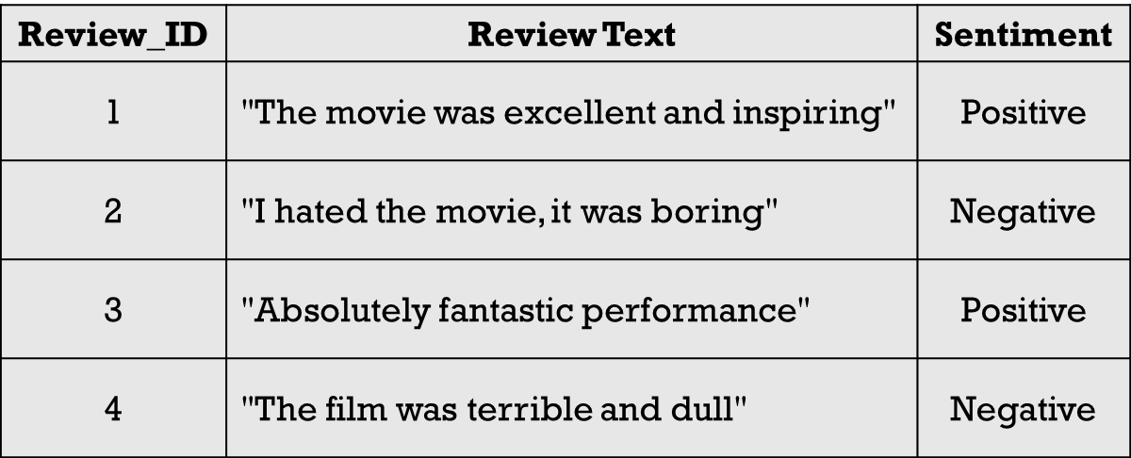
Sentiment analysis using TF-IDF
Step 2: Preprocessing
Convert to lowercase
Remove stopwords (e.g., “was”, “the”)
Tokenize
Example after preprocessing:
["movie", "excellent", "inspiring"]
["hated", "movie", "boring"]
["absolutely", "fantastic", "performance"]
["film", "terrible", "dull"]

Slide 22
Sentiment analysis using TF-IDF
Step 3: Build Vocabulary
Unique words from all reviews:
[movie, excellent, inspiring, hated, boring, absolutely, fantastic, performance, film, terrible, dull]

Slide 23
Sentiment analysis using TF-IDF
Step 4: Compute TF (Term Frequency)
For Review 1 ("movie excellent inspiring"):
TF(movie) = 1/3
TF(excellent) = 1/3
TF(inspiring) = 1/3
Others = 0
Do the same for each review.

Slide 24
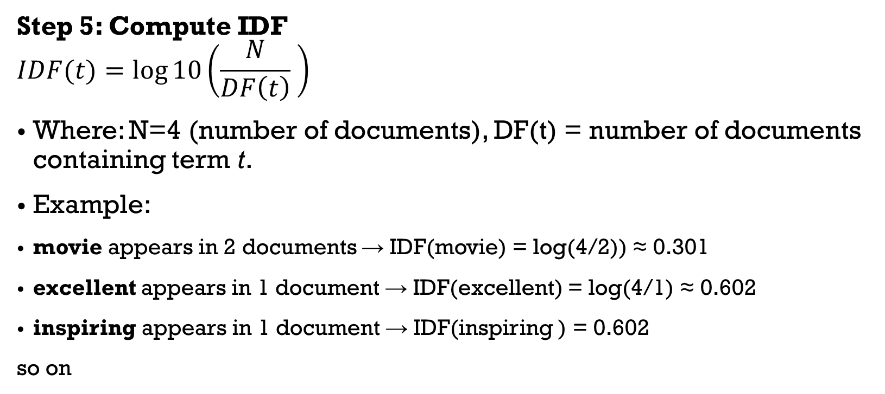
Sentiment analysis using TF-IDF
Step 5: Compute IDF
$$IDF(t)=\log{10​}\left(\frac{N}{DF\left(t\right)} \right)$$
Where: N=4 (number of documents), DF(t) = number of documents containing term t.
Example:
movie appears in 2 documents → IDF(movie) = log(4/2)) ≈ 0.301
excellent appears in 1 document → IDF(excellent) = log(4/1) ≈ 0.602
inspiring appears in 1 document → IDF(inspiring ) = 0.602
so on

Slide 25
Sentiment analysis using TF-IDF
Step 6: TF-IDF Calculation
For Review 1:
TF-IDF(movie) = (1/3) × 0.301 = 0.1003
TF-IDF(excellent) = (1/3) × 0.602 = 0.2007
TF-IDF(inspiring) = (1/3) × 0.602 = 0.2007
So Review 1 is represented as a vector (sparse): [0.1003, 0.2007, 0.2007, 0, 0, 0, 0, 0, 0, 0, 0]
Do this for each review.

Slide 26
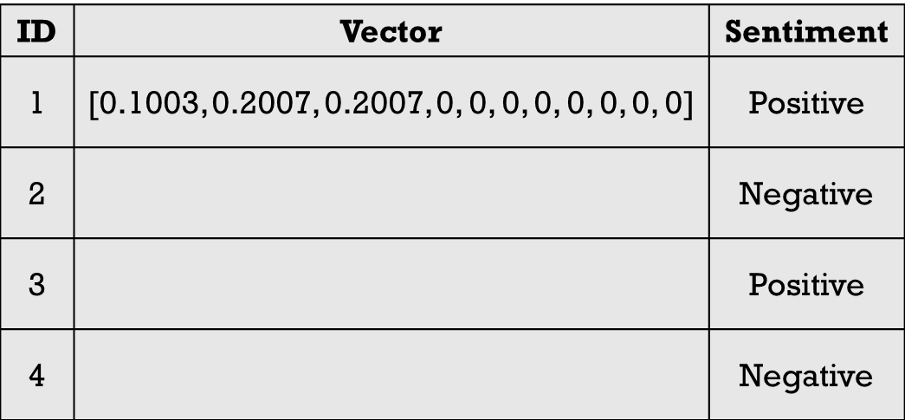
Sentiment analysis using TF-IDF
Step 7: Sentiment Classification (using TF-IDF features)
Now, each review is represented as a vector of TF-IDF weights.
Feed these vectors into a classifier (e.g., Logistic Regression, Naive Bayes, or SVM).
Train the model to predict Sentiment (Positive/Negative).

Slide 27
Topic Modeling
Topic Modeling automatically groups related words and documents without labels.
This is why it’s widely used in news clustering, research paper classification, and social media trend analysis.

Slide 28
Topic Modeling: Example
Suppose we have 5 short documents (like sentences):
"I love playing football and watching cricket.“
"The match last night was an exciting football game.“
"Artificial intelligence and machine learning are fascinating.“
"Deep learning is a branch of artificial intelligence.“
"Cricket and football are popular sports."

Slide 29
Topic Modeling: Example
Step 1: Convert to Bag-of-Words
Each document is represented as words (ignoring order).
Example vocabulary:
football, cricket, match, game, artificial, intelligence, machine, learning, deep, sports]
We then make a document-term matrix (counts of words per document).

Slide 30
Topic Modeling: Example
Step 2: LDA Assumptions
Latent Dirichlet Allocation (LDA) assumes:
Each document is a mixture of topics (probability distribution over topics).
Each topic is a mixture of words (probability distribution over words).
Step 3: Model Finds Topics
If we ask for k = 2 topics, the algorithm might discover:
Topic 1 (Sports): football, cricket, match, game, sports
Topic 2 (AI/ML): artificial, intelligence, machine, learning, deep

Slide 31
Topic Modeling: Example
Step 4: Document–Topic Assignment
Each document gets probabilities for belonging to each topic.
For example:
Step 5: Interpret Topics
Topic 1 = Sports → Football, cricket, game, sports
Topic 2 = Artificial Intelligence → AI, machine learning, deep learning
Document | Topic 1 (Sports) | Topic 2 (AI/ML) | Dominant Topic
1 | 0.85 | 0.15 | Sports
2 | 0.90 | 0.10 | Sports
3 | 0.10 | 0.90 | AI/ML
4 | 0.15 | 0.85 | AI/ML
5 | 0.80 | 0.20 | Sports

Slide 32
Named Entity Recognition (NER)
NER is the process of identifying and classifying named entities (like people, places, organizations, dates, etc.) in text.
Example Sentence
"Barack Obama was born in Honolulu, Hawaii on August 4, 1961, and served as the 44th President of the United States.“
Detected Entities
Barack Obama → PERSON
Honolulu → LOCATION, Hawaii → LOCATION
August 4, 1961 → DATE, 44th President → TITLE
United States → LOCATION/ORGANIZATION

Slide 33
Named Entity Recognition (NER): Application
Information extraction from documents
Building knowledge graphs
Search engines
Chatbots
Analyzing news, social media, or customer feedback

